Slide 1
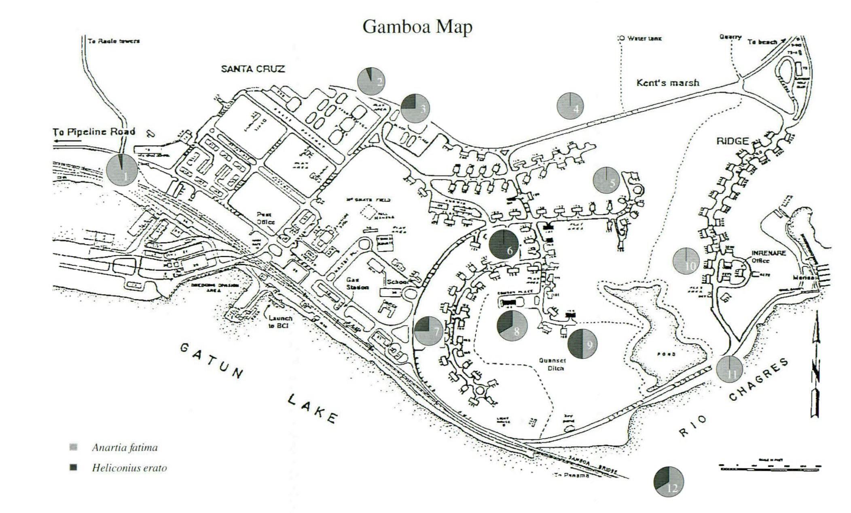
182
Figure 6 - Gamboa site map with distribution and abundance of study butterflies

